Slide 1
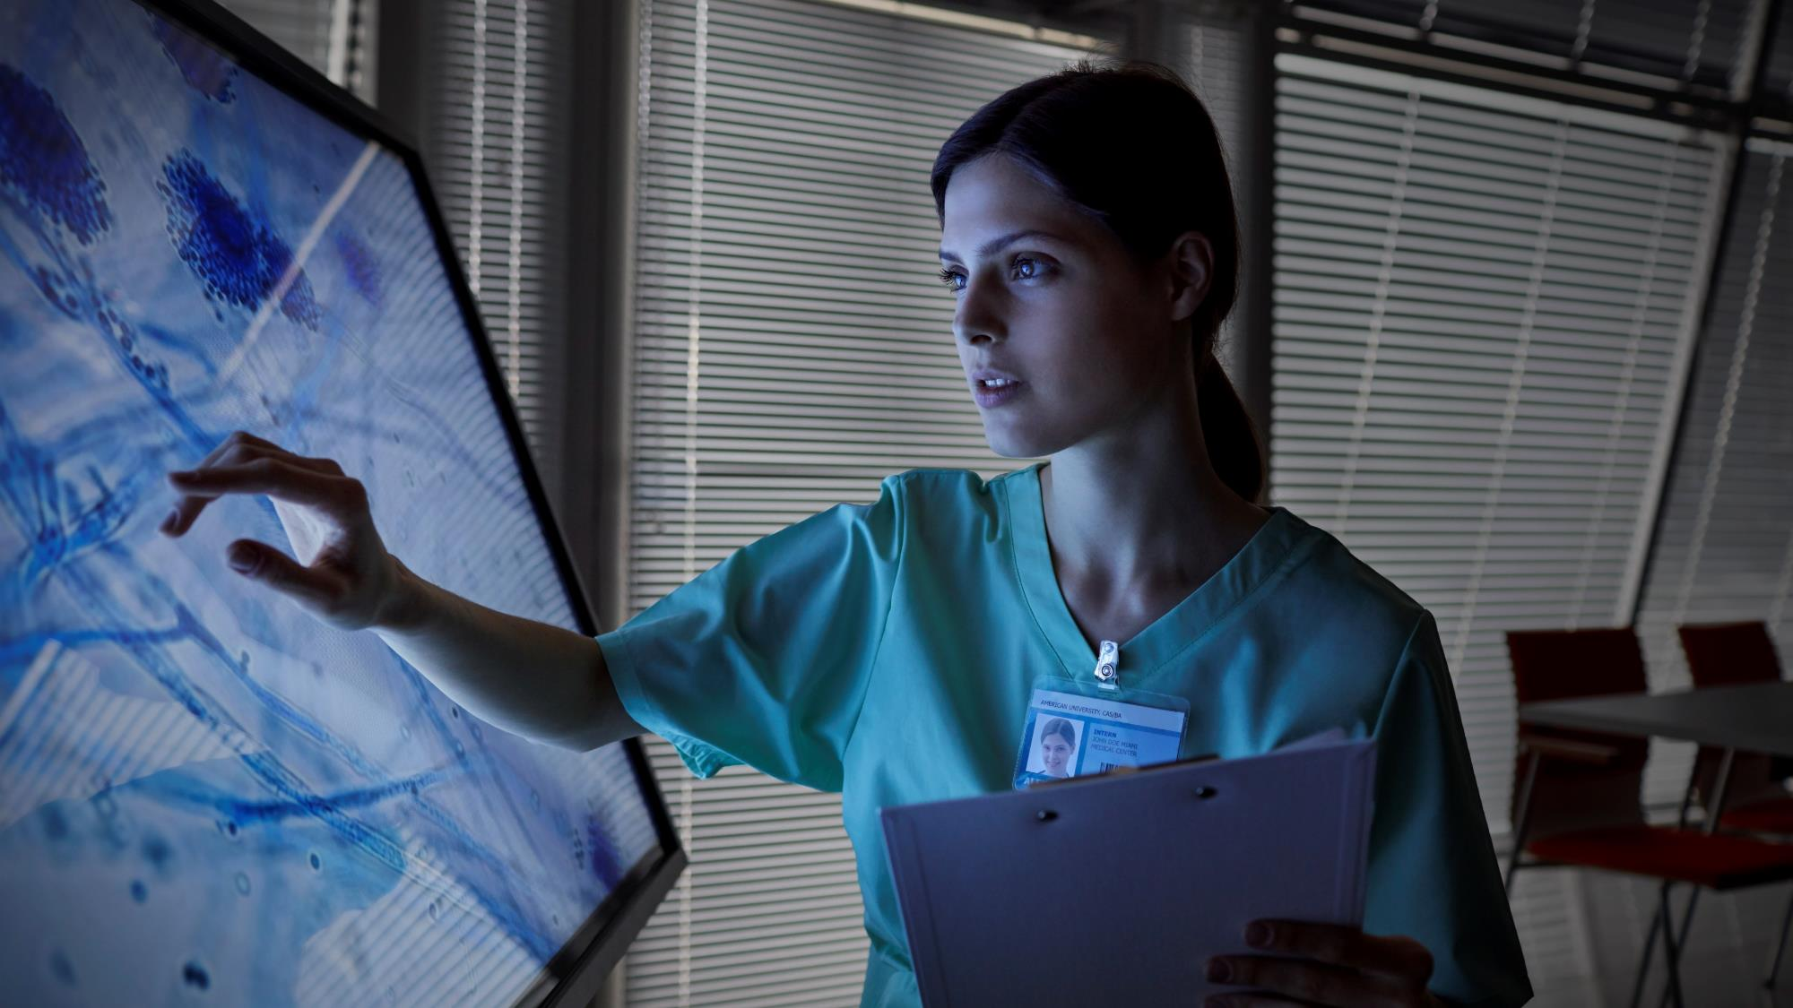

BONE FRACTURE DETECTION USING DEEP LEARNING
Group-05 AI-Powered Fracture Detection

Slide 2
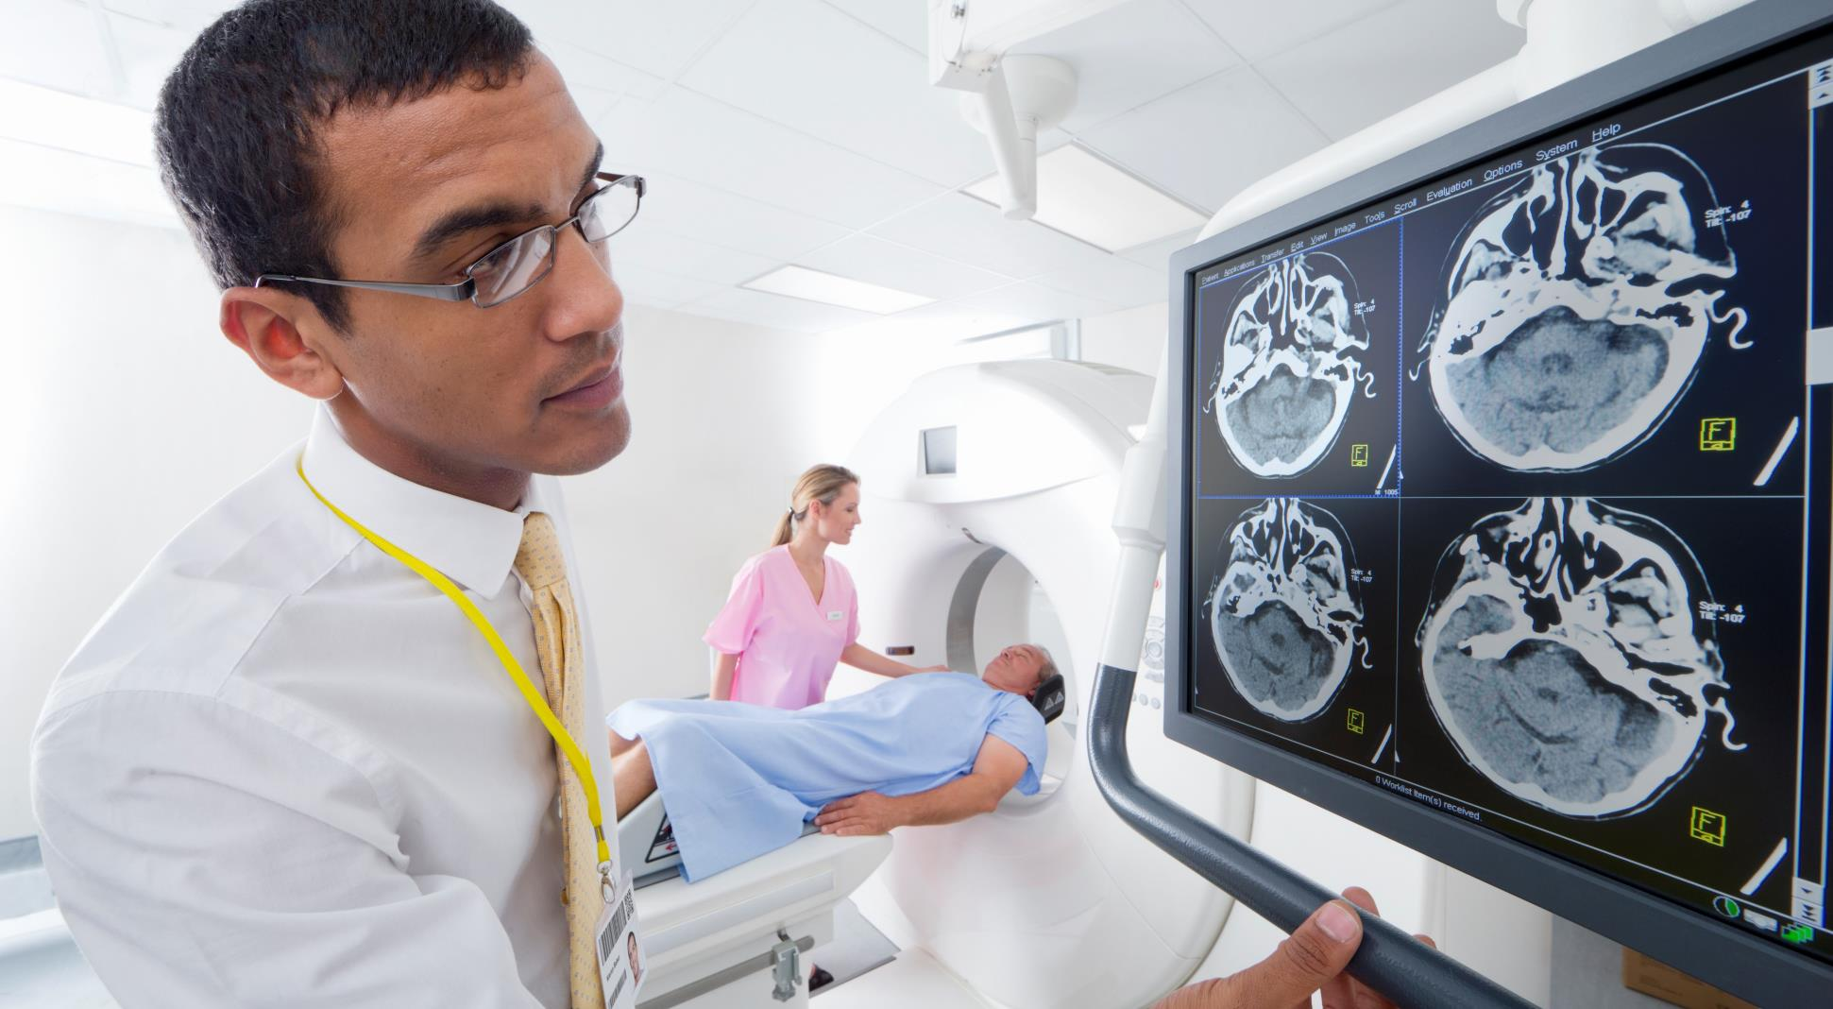
Problem Statement and Objectives
Why is bone fracture detection important?
Importance of bone fracture detection in reducing misdiagnosis and automating radiology workflows.
Challenges with traditional methods, such as manual, time-consuming diagnosis and the need for expert radiologists.
Project objective: Develop an AI model to detect fractures from X-ray images, aiming for quick, accurate, and objective diagnoses to assist radiologists and improve healthcare accessibility
Methodology and dataset
Dataset sourced from ResearchGate, including 1807 training images, 173 validation images, and 83 test images, covering various fracture types (elbow, fingers, forearm, humerus, shoulder, wrist.
Data preprocessing steps: resizing, normalization, augmentation (rotation, flipping).
Model development: Comparison between a custom Convolutional Neural Network (CNN) and a pretrained ResNet-18, with evaluation using accuracy metrics and confusion matrix analysis

Slide 3
TEAM MEMBERS & RESPONSIBILITIES - Group 05
Devidas - Data collection and preprocessing, Image augmentation and normalization, Handling class imbalance (oversampling, synthetic data), and Documentation.
Nachiket- Dataset analysis and visualization, model selection and architecture design, and documentation.
Pooja- Training the deep learning model, hyperparameter tuning and optimization, model validation and performance evaluation, and documentation.
Sachet - Testing on test data, comparing results with existing models, handling overfitting and fine-tuning, improvising previous flaws, validation & performance analysis.

Slide 4
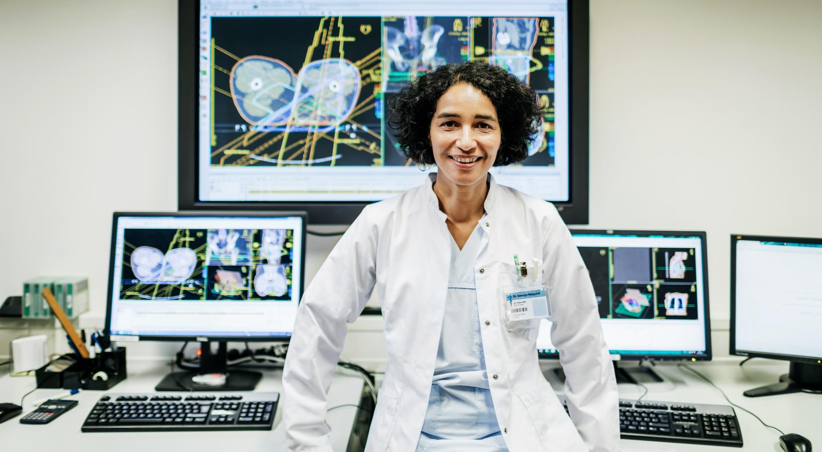
Results, and Challenges
50.8671
Validation Results:
CNN : 50% accuracy; VGG: 89% accuracy; ResNet-18: 90% accuracy.
DenseNet121: 86% accuracy; EfficientNet-B0: 89% accuracy
Challenges:
Overfitting, class imbalance, and computational resource limitations.
Improvements:
Hyperparameter tuning, exploring additional pre-trained models (VGG16, Resnet18, DenseNet121, EfficientNet-B0), image enhancement techniques, and filtering techniques (bilateral filter, clahe filter, clahe median filter, median filtered, imageResize224*224)

Slide 5
METHODOLOGIES / FLOW
Understanding Data and Data Visualization
Data Preprocessing: Resizing, normalization, rotation, image flipping, and scaling
filtering techniques
Model Training: Utilizing a custom CNN, VGG-16, Resnet-18, DenseNet-121,
EfficientNet-B0
Model Evaluation: Analyzing training and testing loss, along with accuracy metrics
Performance Assessment: Confusion matrix analysis
Enhancements and Improvements

Slide 6
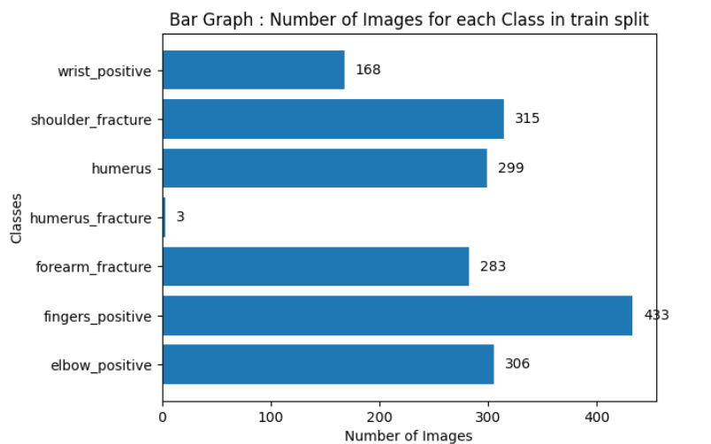
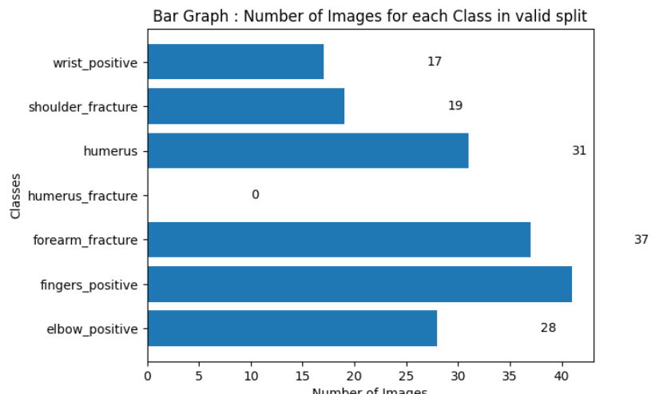
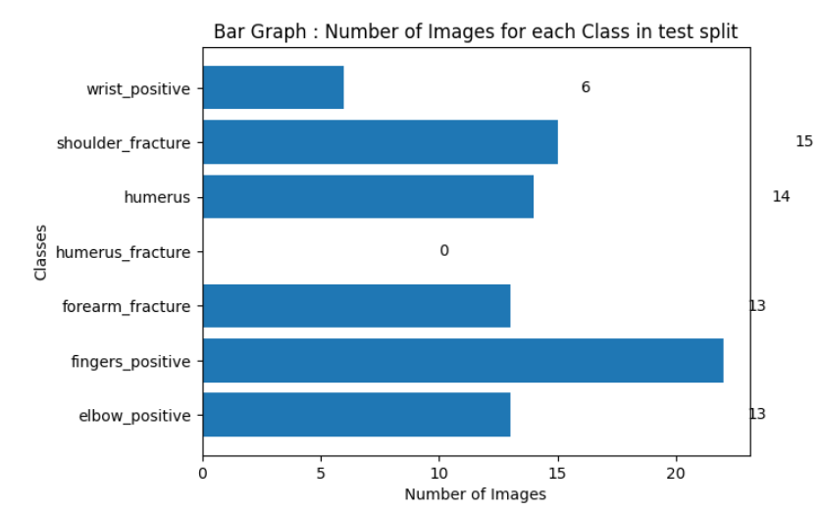
Understanding the Data
Notes:
Overfitting

Slide 7
Filtering Techniques
PSNR measures the quality of an image after processing by comparing it to the original.
Higher PSNR means better quality with less distortion or noise introduced.
40 dB – Excellent, 30–40 dB – Good, 20–30 dB – Acceptable, < 20 dB – Poor quality.
Filter Name | Description | PSNR (average)
Resize (224×224) | Standardizes image size for consistent input to pre-trained models.. | –
CLAHE | Enhances local contrast, making faint structures more visible. Helps expose subtle bone fractures that may not be visible in original X-rays. | 29.7
Median Filter | Removes noise while preserving edges. Cleans up image artifacts so cracks and bone outlines are easier to analyze. | 46.33
CLAHE + Median | Combines contrast enhancement and noise reduction. Sharpens fracture lines and removes distractions, improving fracture visibility. | 40.77
Bilateral Filter | Smoothens images but retains important edges. Maintains bone boundaries and fracture edges while reducing background blur or haze. | 29.7

Slide 8
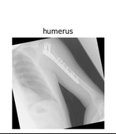
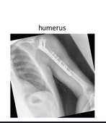
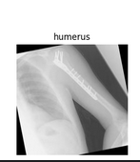
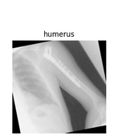
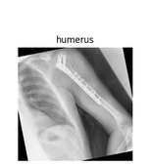
Shoulder fracture Image sample
224*224
CLAHE
Median
Bilateral
Clahe & Median

Slide 9
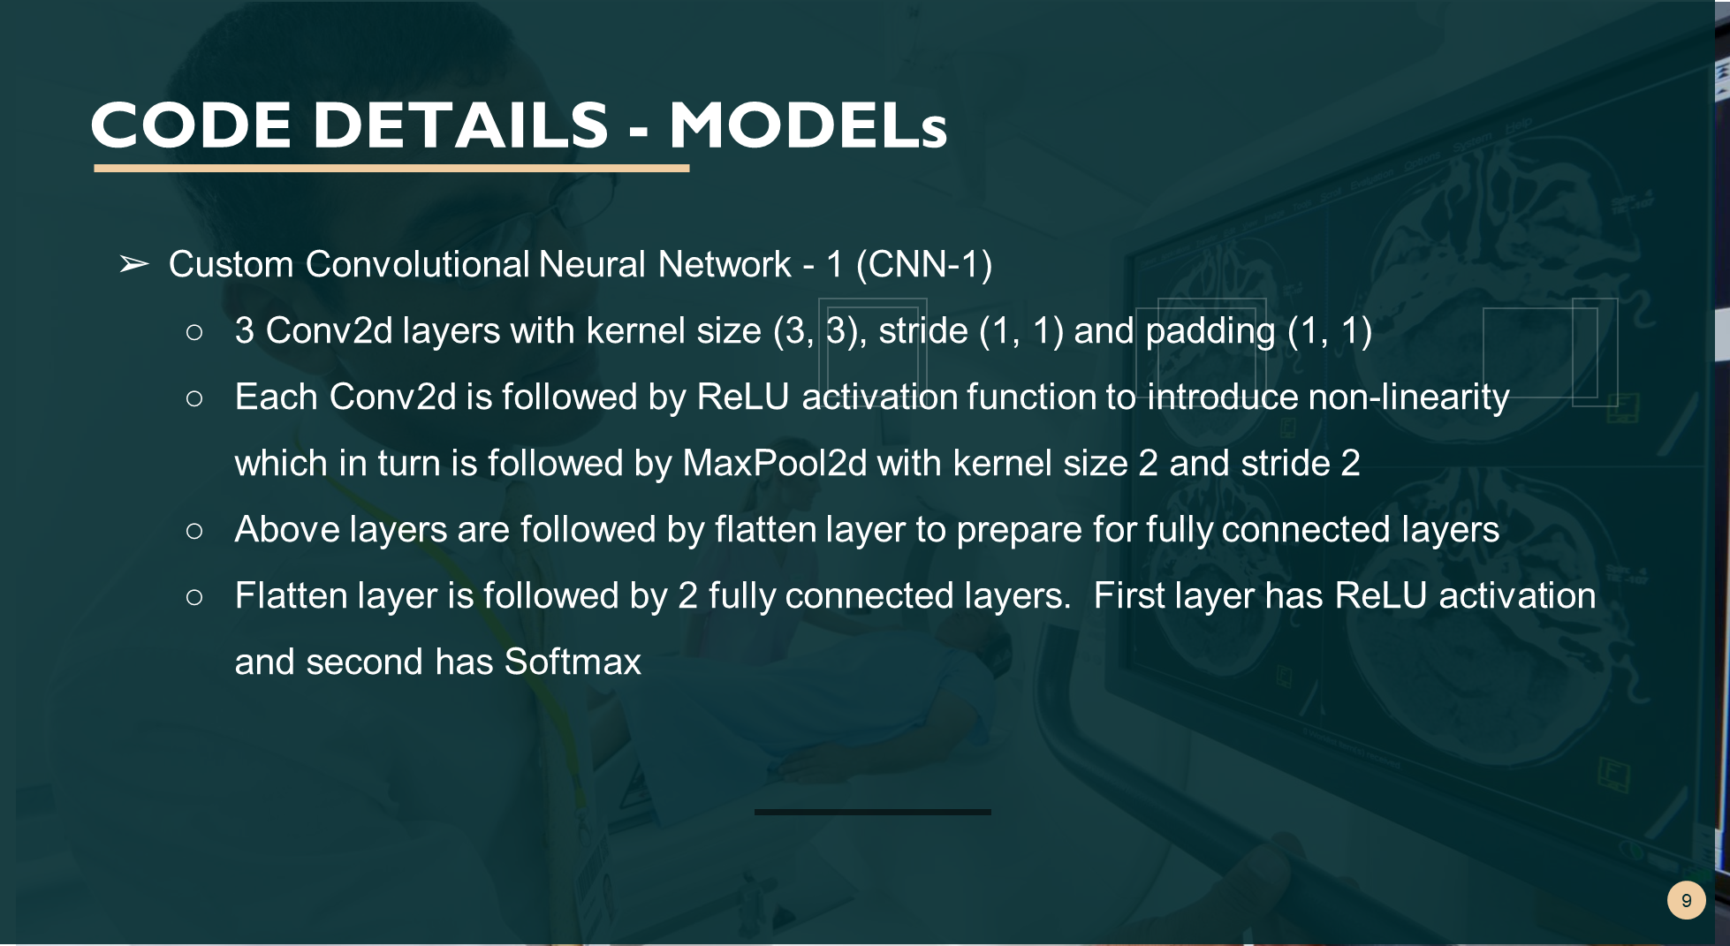
CODE DETAILS - MODELS
Using 2 models for comparison. The one with better performance will be selected for final.
Custom Convolutional Neural Network (CNN)
3 Conv2d layers with kernel size (3, 3), stride (1, 1) and padding (1, 1)
Each Conv2d is followed by ReLU activation function to introduce non-linearity which in turn is followed by MaxPool2d with kernel size 2 and stride 2
Above layers are followed by flatten layer to prepare for fully connected layers
Flatten layer is followed by 2 fully connected layers. First layer has ReLU activation and second has Softmax
ResNet18 (Pretrained)
Replaced the final fully connected layer to match the number of classes (7)

Slide 10
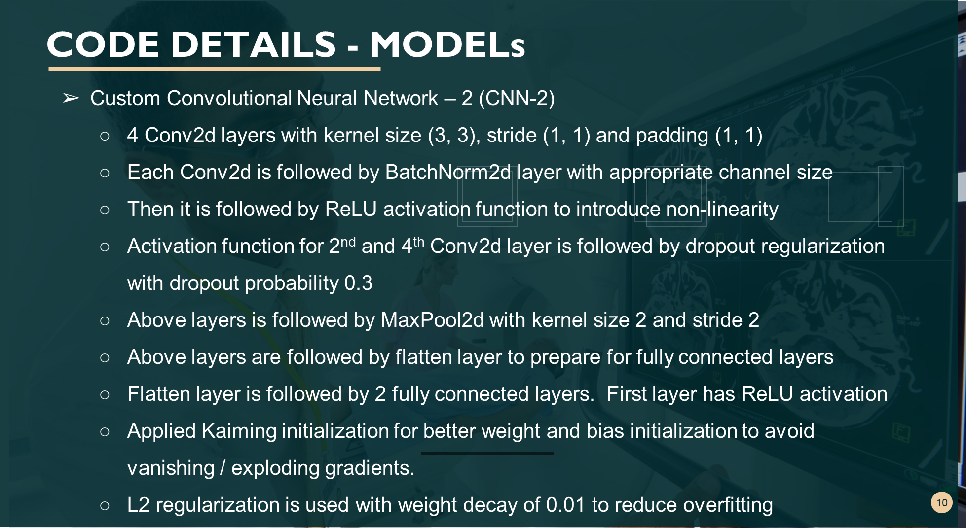
CODE DETAILS - MODELS
Using 2 models for comparison. The one with better performance will be selected for final.
Custom Convolutional Neural Network (CNN)
3 Conv2d layers with kernel size (3, 3), stride (1, 1) and padding (1, 1)
Each Conv2d is followed by ReLU activation function to introduce non-linearity which in turn is followed by MaxPool2d with kernel size 2 and stride 2
Above layers are followed by flatten layer to prepare for fully connected layers
Flatten layer is followed by 2 fully connected layers. First layer has ReLU activation and second has Softmax
ResNet18 (Pretrained)
Replaced the final fully connected layer to match the number of classes (7)

Slide 11
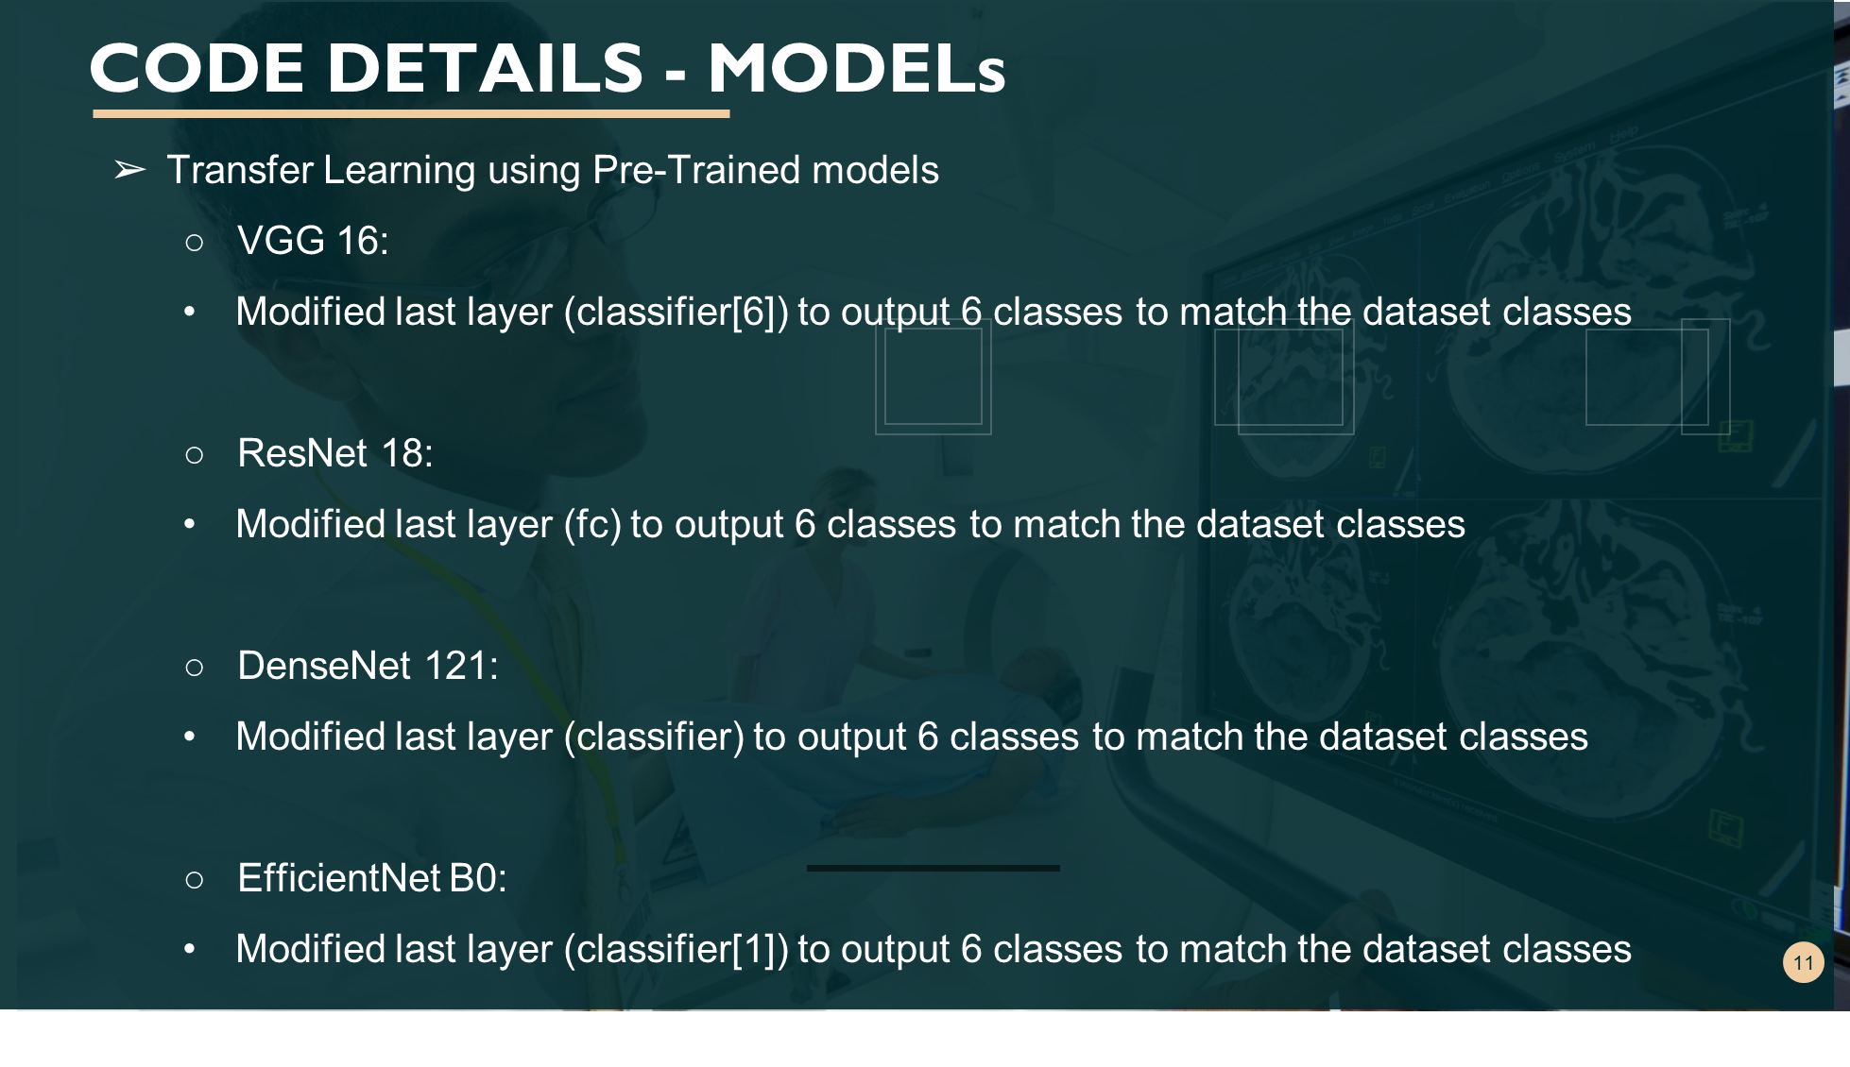
CODE DETAILS - MODELS
Using 2 models for comparison. The one with better performance will be selected for final.
Custom Convolutional Neural Network (CNN)
3 Conv2d layers with kernel size (3, 3), stride (1, 1) and padding (1, 1)
Each Conv2d is followed by ReLU activation function to introduce non-linearity which in turn is followed by MaxPool2d with kernel size 2 and stride 2
Above layers are followed by flatten layer to prepare for fully connected layers
Flatten layer is followed by 2 fully connected layers. First layer has ReLU activation and second has Softmax
ResNet18 (Pretrained)
Replaced the final fully connected layer to match the number of classes (7)

Slide 12
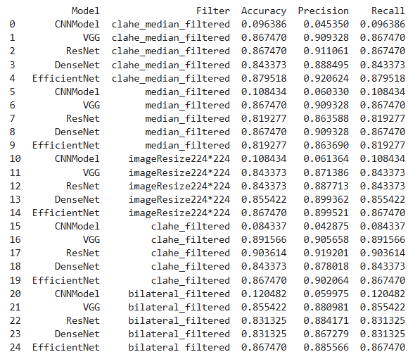
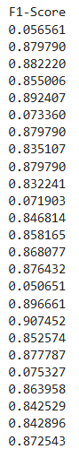
RESULTS
Notes:
Overfitting

Slide 13
CHALLENGES
Overfitting is observed as train & test accuracy in custom CNN model is around 80% and 50% respectively.
Class imbalance affecting predictions.
Applying different filtering techniques.
Computational resource limitations.

Slide 14
IMPROVEMENTS
What improvements were made?
Hyperparameter tuning in CNN model. Eg: learning rate, scheduler parameters, Kaiming initialization, dropout and L2 regularization, batch normalization, number of layers etc.
We used different transfer learning from models like VGG-16, Resnet-18, DenseNet-121, EfficientNet-B0.
Image enhancements noise reduction using filtering techniques like median, CLAHE, Gaussian .

Slide 15
Project Repository & Additional Information
For more details about our project, visit our GitHub repository using the following link. https://github.com/UofMProjects/BoneFractureClassification-v1.0 ( Please use the umich.edu email to access it - Access is already given as the repository is private )

Slide 16

THANK YOU

